Slide 1
ANALYSIS OF THE MOVIE BOX INDUSTRY
Compiled by Group 4;

Slide 2
Business Understanding
Strategic Vision for a New Movie Studio
Objective A leading content creator seeks to expand into the movie industry by launching a new film studio.
Key Insights Needed
Successful Genres: Identify which film genres are thriving and profitable.
Production Budgets: Understand typical costs from production to release.
Revenue Potential: Analyze gross income expectations across different film types.
Primary Goal To evaluate risks and opportunities in the movie industry, ensuring a well-informed entry strategy for sustainable growth.

Slide 3
Problem Statement
Financial Analysis of the Movie Industry
Overview Analyzing production budgets, box office gross, and ROI to uncover what drives movie profitability.
Objectives
Identify key factors for financial success.
Explore the link between budget size and profitability.
Approach
Use datasets to analyze trends.
Apply visualizations, predictive models, and hypothesis testing.
Outcome Insights to inform strategic decisions in film production and budgeting.

Slide 4
Data Overview
The Datasets involved include;
IMDB Data ; includes titles, release years, genres, and IMDB ratings
Box Office Mojo Data ; has detailed financial information like production budgets, domestic and worldwide gross earnings.
Supplementary Data ; this is additional information such as directors and other variables influencing the movies financial performance

Slide 5
Data Cleaning
Our first step was to load the datasets, then the cleaning involved ;
Handling missing values by either filling them appropriately or dropping them.
Removing duplicate entries to ensure data integrity.
Formatting of columns i.e converting dates, numerical values e.t.c

Slide 6
Data Analysis
Analysis of ROI and Profit by Budget Size
Overview Analyzed ROI and profit distribution across different budget sizes.
Methods
Correlation heatmaps and scatterplots to reveal patterns.
Visualizations of key financial metrics (e.g., budget vs. worldwide gross).
Insights Identified relationships between budget size, ROI, and overall profitability.

Slide 7
VISUALIZATIONS

Slide 8
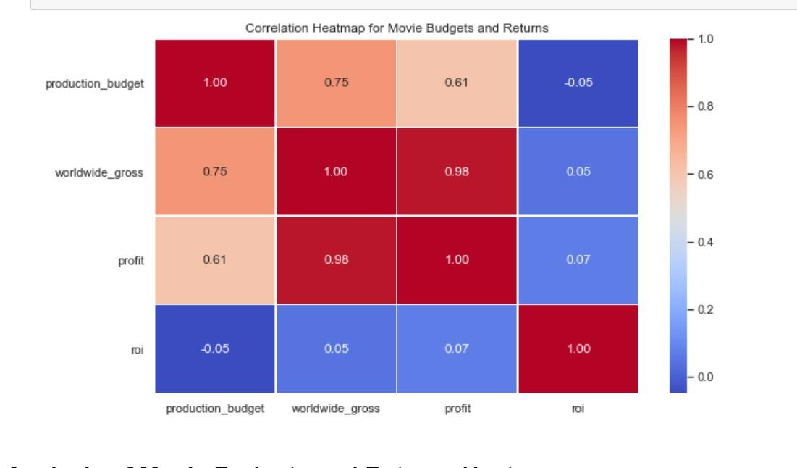

Slide 9
Correlation Heatmap
This is a correlation heatmap showing the relationship between a movie's production budget, worldwide gross, profit, and return on investment (ROI).
Strong positive correlations (close to 1) are shown in red and indicate that as one variable increases, the other tends to increase as well. For example, worldwide gross and profit have a very strong positive correlation of 0.98.
Weak or no correlations (close to 0) are shown in lighter colors and indicate that there is little to no relationship between the variables. For example, production budget and ROI have a very weak negative correlation of -0.05.

Slide 10
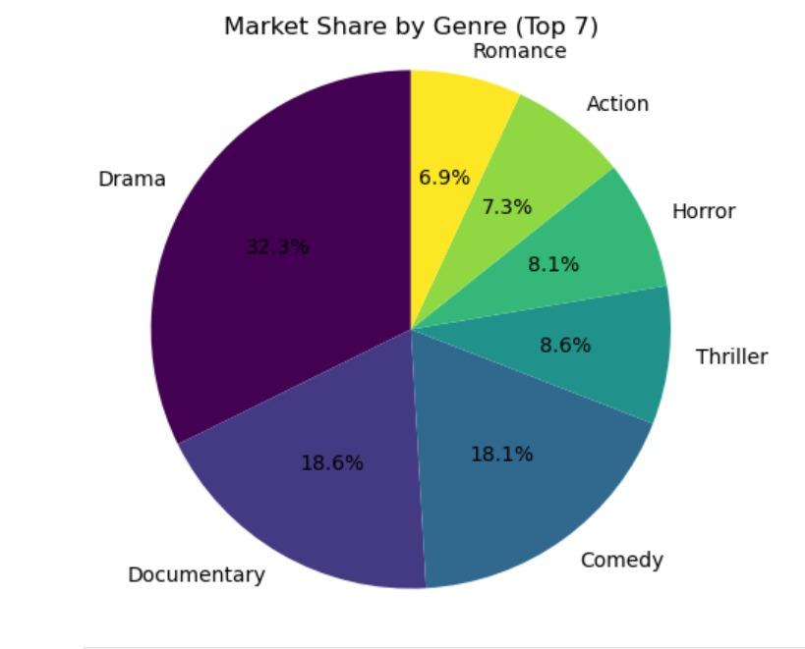

Slide 11
Market Share by the Top Movies.
The pie chart illustrates the market share of the top seven movie genres. Drama dominates with the largest share at 32.3%, followed by Documentary and Comedy with 18.6% and 18.1% respectively. Thriller and Horror hold considerable shares at 8.6% and 8.1%. Action follows with 7.3% and Romance rounds out the top seven with 6.9%.

Slide 12
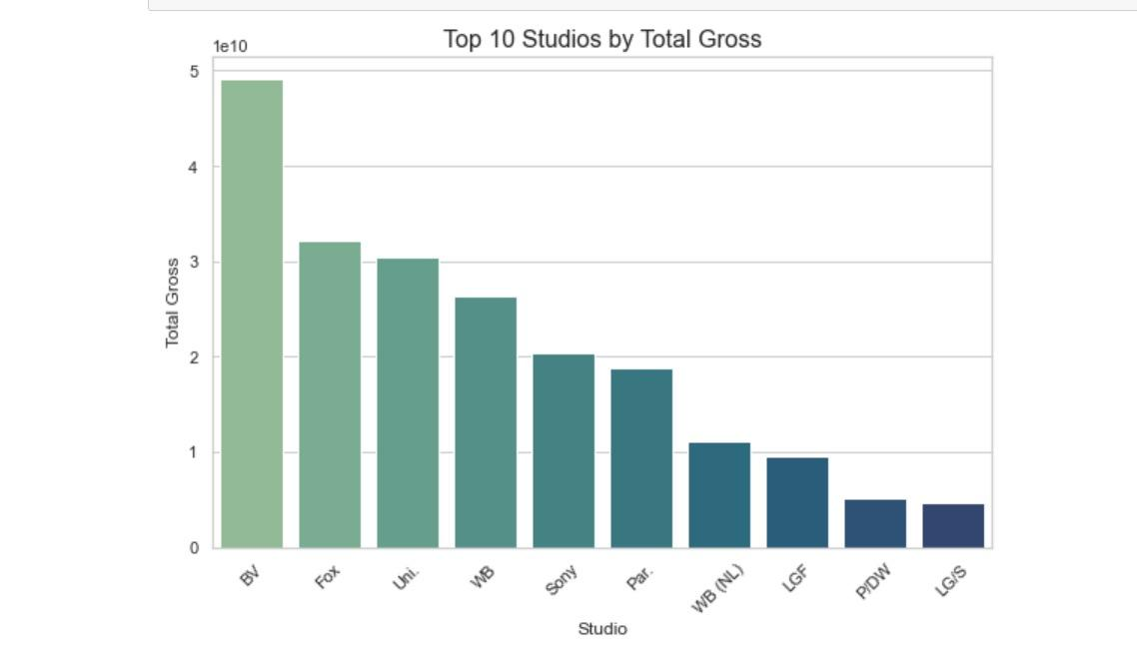

Slide 13
This bargraph shows the top ten most profitable studios in the market where the total gross is the sum of foreign gross and domestic gross

Slide 14
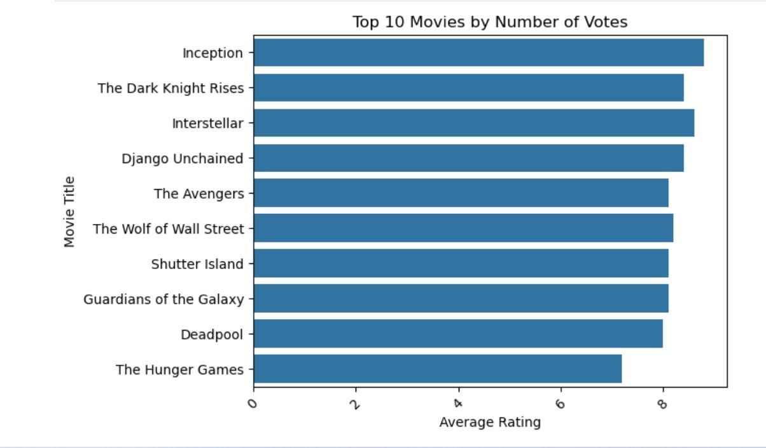

Slide 15
Here we plot the average ratings against movie title to get a glimpse of the top most rated views and their genre

Slide 16
Recommendations
After all this analysis , we come to the conclusion that studios like BV and Fox make the most profit out of all. When considering bench marking these are the studios to consider.
Secondly, according to the market share, the genre doing great are the drama. This shows that if the company wants to make more profit it should major in Drama/Shorts, Documentaries , comedies e.t.c
Lastly the budget and the producer of the film contribute in the success and profits from the movie. This does not exclude the actors too.
In conclusion, the movie industry is evolving and success can be guaranteed by keeping up with the latest trend and what the people like. This means being updated by the ratings of previous movies especially from competitors.

Slide 17
Thank you for your time.
Au-revoir
Project Done by : Boniface Ngechu Abdihakim Isaack Imran Mahfoudh Batuli Abdallah Linet Lydia

